Slide 1
Weekly report
Pro. Huang && Shuo Zhang

Slide 2

ICDM 2020

Slide 3
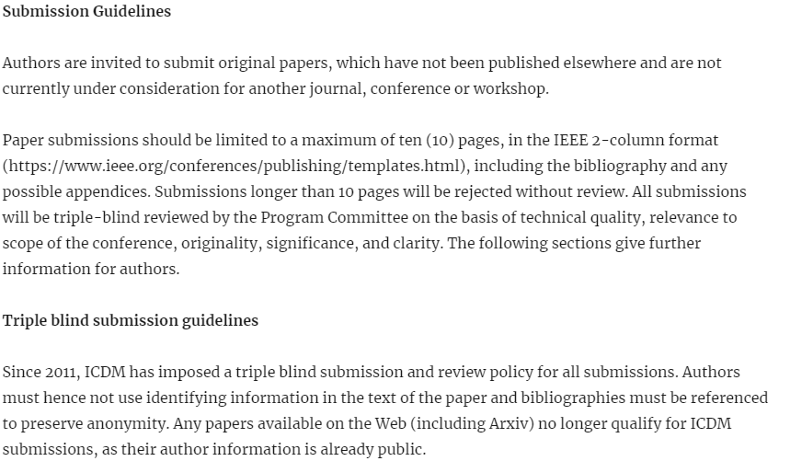
ICDM 2020

Slide 4
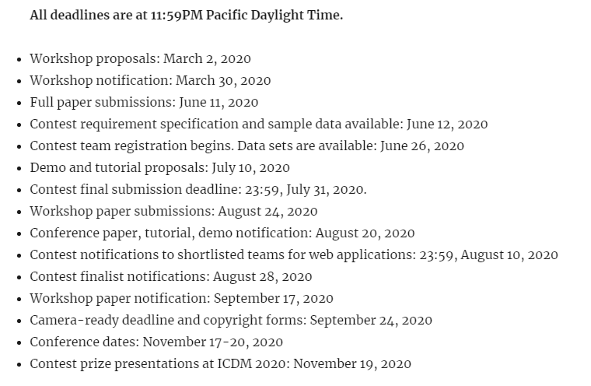
ICDM 2020

Slide 5
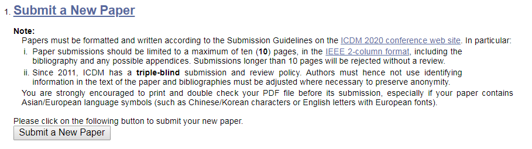
ICDM 2020

Slide 6
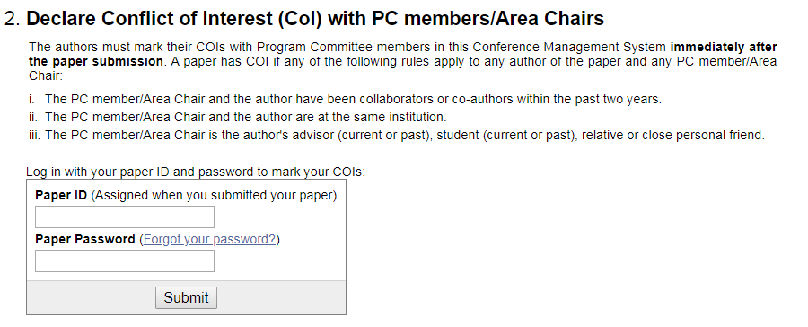
ICDM 2020

Slide 7
Thanks
@MICC

